Slide 1
Pipes
Better connectivity

Slide 2
What are pipes?
Pipes are the one of the IPC mechanism to establish communication
b/w the processes.
Types of Pipes:
Unnamed Pipes ( pipes)
Unnamed pipes also called as Pipes
Named pipes( FIFOs)

Slide 3
Pipes : Unnamed Pipes
Simple and flexible
It allows only related process to access.
Pipe() returns two descriptors to read and write
Best suitable to implement Producer/Consumer interaction
among processes.
It doesn’t have user mode process synchronization facility.
Using this, output of one program can be fed to input of other
Data is processed in first in first out basis

Slide 4
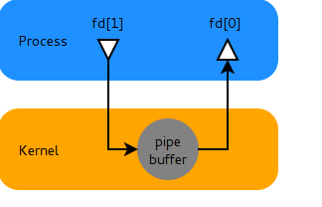
Pipe is in the kernel space
Pipes : what is a pipe
We use the term pipe when we connected a data flow from one process to another.
In Linux, we are familiar with a pipe “ | ” which is used for linking shell commands.
Ex:
$ cmd1 | cmd2
fd[0] --------------read end of the pipe
fd[1] --------------write end of the pipe

Slide 5
System calls related to pipe
1.creating a pipe in the Linux : pipe()
2.Writing data into the pipe : write()
3.Reading data from the pipe: read();
4.Closing the pipe :close()
Pipes : Standard Descriptors
These are standard values that already assigned for actions
STDIN = 0 ----- Read (Standard Input )
STDOUT = 1 ----- Write (Standard Output )
STDERR = 2 ----- Error (Standard Error )

Slide 6
Pipe b/w child and Parent
parent process
child process
fork
readfd
readfd
writefd
writefd
pipe
flow of data
kernel

Slide 7
Advantages of pipe
Easy to connect b/w two running processes
The output of one process will fed input to other process
Disadvantage of pipes
Pipes are used to communicate b/w related process only(child & parent)
There is no way to open an already existing pipe
Process persistent buffer stream

Slide 8
Pipes : Named Pipes (FIFO)
It is a special type of file.
It allows unrelated processes to communicate with each
other
Best suitable to implement client and server application
It accepts path name rather than a descriptor
We can’t open a FIFO in both read and write mode
It has limit on how much data can be store in one FIFO
(4k bytes)
We can use unlink like in file operation to remove FIFO

Slide 9
Pipes : Crating a FIFO
At Shell
$pwd
/home/user/temp
$ mkfifo my_fifo
$ echo “welcome to Mirafra “ >/temp/my_fifo
In Program
int mkfifo(const char *filename , mode_t mode );
filename ---- Name of the FIFO
mode ---- Permissions

Slide 10
Pipes : Opening FIFO with Open call
There are four legal combinations with different flag options
int open( const char *path, O_RDONLY ) ;
int open( const char *path, O_RDONLY |O_NONBLOCK);
int open( const char *path, O_WRONLY ) ;
int open( const char *path, O_WRONLY |O_NONBLOCK);

Slide 11
Pipes : Reading and Writing
Both reading and writing operations are same as on files
int read( id, buffer , size);
int write(id, buffer , size);
id ----- Descriptor returned by open()
buffer ----- Character buffer
size ----- Size of buffer

Slide 12
Pipes : Sample Program – FIFO
/* Creating FIFO and writing into that some data */
#define fname “/temp/my_fifo”
int f1;
char buffer[20];
mkfifo(fname, 0777);
f1=open(fname,O_WRONLY|O_NONBLOCK);
printf(“Enter data \n”);
scanf(“%s”,buffer);
write(f1,buffer,size of(buffer) ) ;
close(f1);

Slide 13
Pipes : Sample Program – FIFO (contd..)
/* Reading from FIFO */
f2=open(fname,O_RDONLY|O_NONBLOCK);
read(f2,buffer,size of(buffer) ) ;
printf(“Reading from FIFO \n %s ”,buffer);
close(f2);
output
Enter data
Welcome To Mirafra
Reading from FIFO
Welcome To Mirafra

Slide 14
Pipes : Sample Program – FIFO
// this program demostrate FIFOs.
#include<fcntl.h>
#include<stdio.h>
int main()
{
int fd;
char buffer[25];
mknod("myfifo",010666,0);//three para:name 010 for pipe 666 for permission,
fd=open("myfifo",O_RDWR);
for (;;)
{
read(fd,buffer,25);
printf("%s\n",buffer);
}
}

Slide 15
Pipes : Sample Program – FIFO
#include<fcntl.h>
#include<stdio.h>
main(int argc,char *argv[])
{
int fd;
int counter;
char buffer[25];
if(argc<2)
{
printf("usage:<filename><message><message>...\n");
exit(1);
}
fd=open("myfifo",O_WRONLY);
for(counter=0;counter<argc;counter++)
{
strcpy(buffer, argv[counter]);
write(fd,buffer,25);
}
exit(0);
}

Slide 16
Pipes : Summary
Advantage and disadvantages of pipes
Easy to implement connection between running processes
Both related and unrelated process can access
Same file operations within limit we can use
Synchronization is required
Exists only as long as the descriptors are open
Does not define message boundaries

Slide 17
Message Queues
Chatting ?

Slide 18
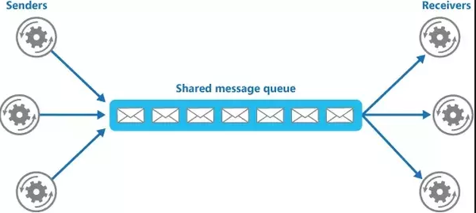
Message queue
Message Queues give you another way to send information from one task to another

Slide 19
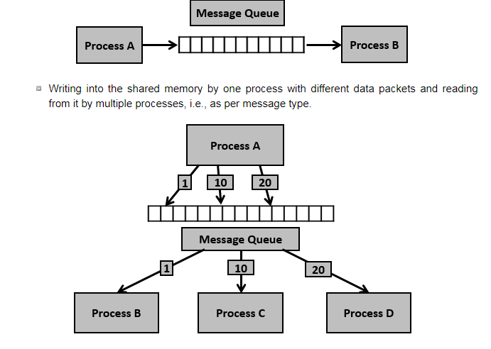
Message queue

Slide 20
Message Queues : Features of Message Queue
Easy and efficient .
Used between related and unrelated process.
Provide sending block of data.
Blocking & Synchronization problems are avoided.
It has inbuilt synchronization
After reading message will be deleted from queue.
It has some limits on size(max message size 8192 bytes)

Slide 21
System Calls related to Message Queue

Slide 22
Message Queues : msgget System call
int msgget( key_t key,
int msgflag );
key ------- An arbitrary number or IPC_PRIVATE
msgflag
IPC_CREAT
IPC_EXCL

Slide 23
Message Queues : Message Structure
/* Message structure */
struct message
{
long int mtype;
char mtext[n];
};

Slide 24
Message Queues : msgsnd System Call
int msgsnd(
int msqid,
const void *msg_ptr,
size_t msg_sz
int msgflag
);
Message Queues : msgrcv System Call
int msgrcv(
int msqid, void *msg_ptr, size_t msg_sz, long int mtype,
int msgflag
) ;
msqid -------- Message Queue id return by msgget()
msg_ptr ------- Pointer to the message structure
msg_sz ------- Size of the message pointed to by msg_ptr

Slide 25
Message Queues : msg_type
msg_type
0
First message in the queue is read
>0
First message on the queue of type msg_typ is read, unless MSG_EXCEPT was asserted in msgflg, in which case the first message on the queue of type not equal to msg_type will be read
<0
The first message on the queue with the lowest type less than or equal to the absolute value of msg_typ will be read

Slide 26
Message Queues : msg_flag
msgflag
IPC_NOWAIT
Return immediately if no message of requested type is on the queue
MSG_EXCEPT
Used with msg_type greater than 0 to read the first message on the queue with message type that differs from msg_type
MSG_NOERROR
Truncate the message if longer than msgsz bytes

Slide 27
Message Queues : msgctl System Call
int msgctl(
int msqid, int cmd, struct msqid_ds *buf );

Slide 28
Message Queues : Parameters
msqid -------- Message Queue id
cmd
IPC_STAT
Copy information from the message queue data structure into the structure pointed to by buf
IPC_SET
Write the values of some members of msqid_ds structure pointed to by buf to the message queue data structure. Considered members from the user defined structure are msg_perm.uid, msg_perm.gid, msg_perm.mode, msg_qbytes
IPC_RMID
Remove the message queue and its data structures
buf ------ Modes

Slide 29
Message Queues : msqid_ds Structure
struct msqid_ds {
struct ipc_perm msg_perm;
struct msg *msg_first; /* first message on queue */
struct msg *msg_last; /* last message in queue */
time_t msg_stime; /* last msgsnd time */
time_t msg_rtime; /* last msgrcv time */
time_t msg_ctime; /* last change time */
struct wait_queue *wwait;
struct wait_queue *rwait;
ushort msg_cbytes;
ushort msg_qnum;
ushort msg_qbytes; /* max number of bytes on queue */
ushort msg_lspid; /* pid of last msgsnd */
ushort msg_lrpid; /* last receive pid */
}
Notes:
msg_perm An instance of the ipc_perm structure, which is defined for us in linux/ipc.h. This holds the permission information for the message queue, including the access permissions, and information about the creator of the queue (uid, etc).
msg_first Link to the first message in the queue (the head of the list).
msg_last Link to the last message in the queue (the tail of the list).
msg_stime Timestamp (time_t) of the last message that was sent to the queue.
msg_rtime Timestamp of the last message retrieved from the queue.
msg_ctime Timestamp of the last ``change'' made to the queue (more on this later).
wwait and
rwait Pointers into the kernel's wait queue. They are used when an operation on a message queue deems the process go into a sleep state (i.e. queue is full and the process is waiting for an opening).
msg_cbytes Total number of bytes residing on the queue (sum of the sizes of all messages).
msg_qnum Number of messages currently in the queue.
msg_qbytes Maximum number of bytes on the queue.
msg_lspid The PID of the process who sent the last message.
msg_lrpid The PID of the process who retrieved the last message

Slide 30
SAMPLE PROGRAM

Slide 31
Message Queues : Creating Message Queue
int mid;
int main()
{
printf("Creating Message Queue \n");
mid = msgget(10,IPC_CREAT);
if( mid < 0)
printf("Unable to Create Message Queue \n");
else
printf("Message Queue is Created Successfully \n");
system("ipcs");
return 0;
}

Slide 32
Message Queues : Send Data Into Message Queue
int main()
{
struct message send_msg;
printf("Creating Message Queue \n");
mid = msgget(10,IPC_CREAT);
send_msg.mtype = 1;
strcpy(send_msg.mdata,"Hello");
msgsnd(mid,(void *)&send_msg,sizeof(send_msg),0);
system("ipcs");
msgsnd(mid,(void *)&send_msg,sizeof(send_msg),0);
system("ipcs");
return 0;
}
int mid;
struct message
{
long int mtype;
char mdata[30];
};

Slide 33
Message Queues : Read Data From Message Queue
int mid;
struct message
{
long int mtype;
char mdata[30];
};
int main()
{
struct message recv_msg;.
printf("Creating Message Queue \n");
mid = msgget(10,IPC_CREAT);
msgrcv(mid,(void *)&recv_msg,sizeof(recv_msg),1,0);
printf("The Message Read is %s \n",recv_msg.mdata);
system("ipcs");
return 0;
}

Slide 34
Message Queues : Delete Message Queue
int main()
{
printf("Creating Message Queue \n");
mid = msgget(10,IPC_CREAT);
msgctl(mid,IPC_RMID,0);
system("ipcs");
return 0;
}

Slide 35
Message Queues : Message Queue b/w related Process
int main()
{
struct message send_msg;
struct message recv_msg;
int pid;
printf("Creating Message Queue \n");
mid = msgget(10,IPC_CREAT);
pid = fork();
int mid;
struct message
{
long int mtype;
char mdata[30];
};

Slide 36
Message Queues
if(pid == 0) //Child Process
{
printf("Child Process is writing data into Message Queue \n");
send_msg.mtype = 1;
strcpy(send_msg.mdata,"Hello");
msgsnd(mid,(void*)&send_msg,sizeof(send_msg),0);
system("ipcs");
}
else //Parent Process
{
sleep(3);
printf("Parent Process is reading data from Message Queue \n");
msgrcv(mid,(void *)&recv_msg,sizeof(recv_msg),1,0);
printf ("Read Data is : %s \n",recv_msg.mdata);
system("ipcs");
}
return 0;
}

Slide 37
/* Message structure */
struct message
{
long int mtype;
char mtext[12];
}msg_snd,msg_rcv ;
/*Creating Message Queue */
int msqid,i;
if ((msqid=msgget(0,IPC_CREAT|0666))= = -1)
{
perror (“error”);
exit(0);
}
/*Sending messages */
for(i=1;i<4;++)
{
msg_snd.mtype=i;
printf (“ Enter different strings\n”);
scanf(“%s”,msg_send.mtext);
if (msgsnd (msqid,&msg_snd,sizeof (msg_snd),0)= = -1 )
{
perror (“error”) ;
exit(0);
}
}

Slide 38
Message Queues : Sample Program contd..
/* Receiving messages */
for(i=1;i<4;++)
{
if (msgrcv(msqid,&msg_rcv,sizeof (msg_rcv), i ,0)= = -1 )
{
perror(“error”) ;
exit(0);
}
printf (“Received message is %s \n ”,msg_rcv.mtext);
}
/* Removing Message Queue */
msgctl(msqid,IPC_RMID,0);

Slide 39

Message Queues : Sample Program contd..
Sender
Receiver
mtype--- 3
HYD
mtype---2
Welcome to
mtype--- 1
Hai
Out Put
Enter different string Received string is Hai
Hai
Enter different string Received string is Welcome to
Welcome to
Enter different string Received string is HYD
HYD

Slide 40
Shared Memory
Share with me

